Slide 1

DEEP LEARNING CA2 PART B: Reinforcement Learning
By: Ng Yan Jie (p2128818)
Yek Yi Wei (p2107631)
Diploma in Applied AI & Analytics

Slide 2
Background Research
The Lunar Lander dataset is a simulation of a lunar landing mission, used as an example for reinforcement learning task.
Objective
Safely land a lunar lander spacecraft on the surface of the moon.

Slide 3
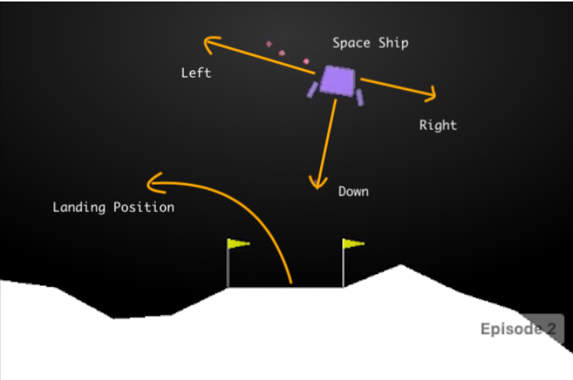
Background Research
Observation Space:
x-coordinate of the lander
y-coordinate of the lander
velocity in the x-direction
velocity in the y-direction
angle of the lander
angular velocity
1 if first leg has landed, else 0
1 if second leg has landed, else 0

Slide 4
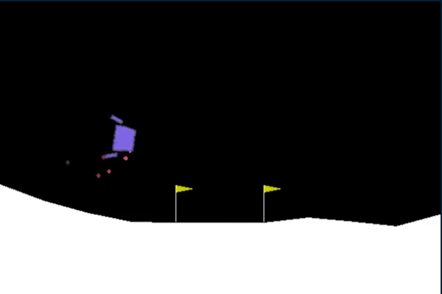
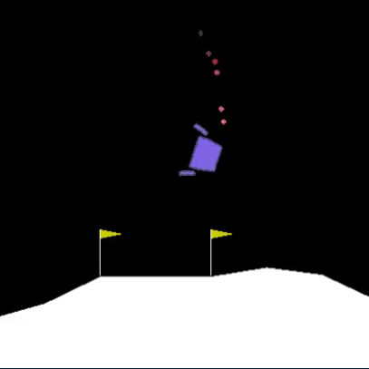
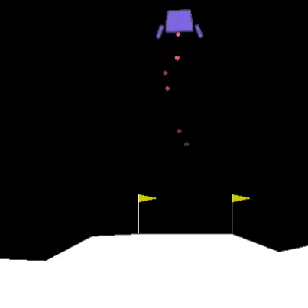
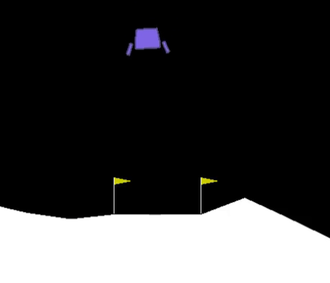
Background Research
1:
3:
Action Space:
0 (Do nothing)
1 (Fire the left orientation engine)
2 (Fire the main engine)
3 (Fire the right orientation engine)
2:
0:

Slide 5
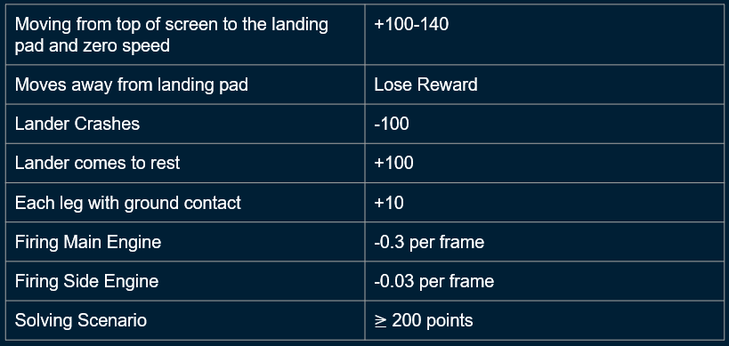
Reward Space

Slide 6
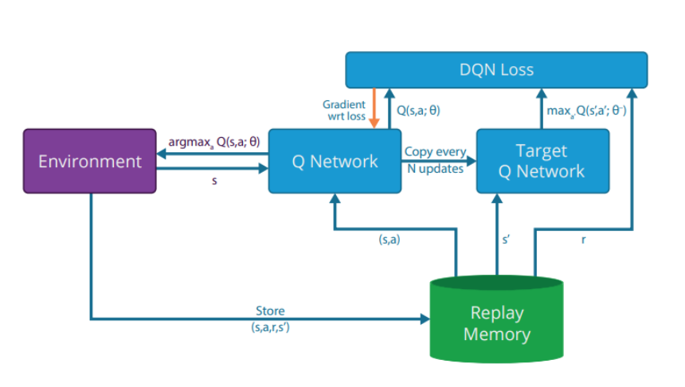
What is Deep Q-Network (DQN)
Deep Q Learning uses the Q-learning idea. It uses a Neural Network that takes a state and approximates the Q-values for each action based on that state
Advantages
End-to-end learning
Model-free learning
High sample efficiency
Generalization
Online learning
Parallelization

Slide 7
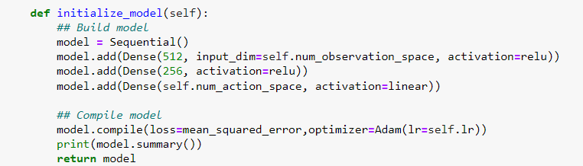

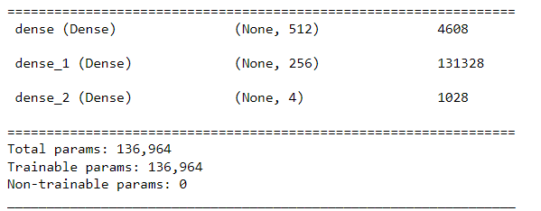
Deep Q Network Architecture
Input layer taking in 8 states
Two Fully Connected Hidden Layers with 256 nodes with ReLU
Fully Connected Output Layer with 4 nodes
Compiled with MSE Loss and Adam Optimizer

Slide 8
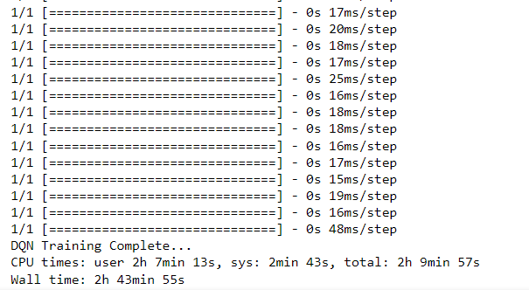
Training
Environment simulation
Initialization
Experience collection
Training
Target network updates
Exploration-exploitation
Repeat

Slide 9
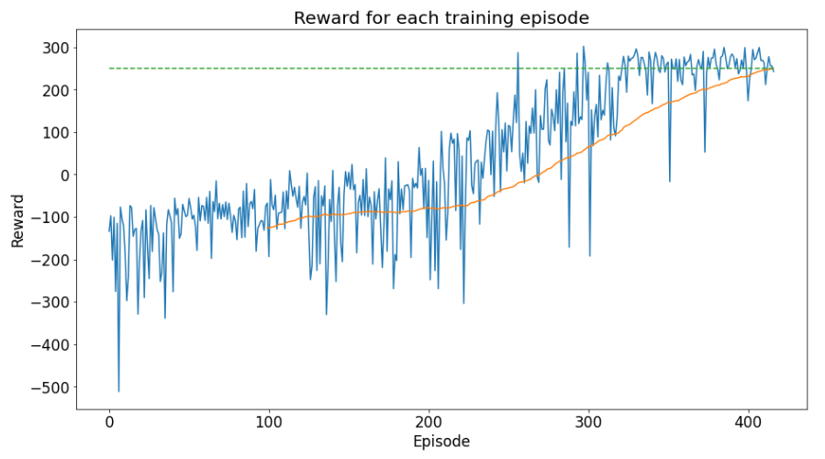
DQN Train 1000 Episodes
Target met at episode 416

Slide 10
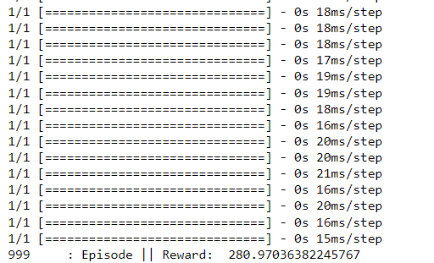
Testing
Create a testing environment
Load the pre-trained DQN model
Run the agent in the environment
Evaluate the collected data and compare it to the desired performance metrics
Repeat the testing process 1000 times

Slide 11
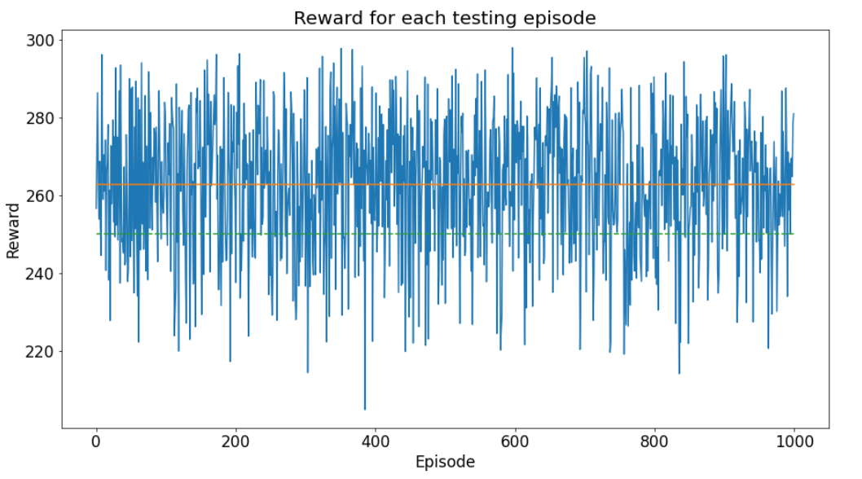
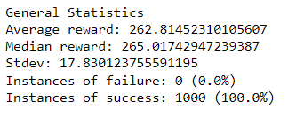
DQN Test 100 episodes

Slide 12
Tune hyperparameters
Model aced the test (100% success)
Time constraint
Hyperparameters to tune
Gamma
Learning Rate
Epsilon Decay

Slide 13
Conclusion
Given more time, we would have further developed this model into DDQN and D3QN.
We also wanted to try models with the actor-critic architecture such as AC, A2C, PPO, and TRPO. However, we had to keep in mind the nature of the difficulty of this task, which does not require such complex algorithms to be able to ace the task.

